Slide 1
The State of Social and Personality Science: Rotten to the Core, Not So Bad, Getting Better, or Getting Worse?
Motly et. al (2017)
Political Psychology Lab.
2018/03
METU
Sami Çoksan

Slide 2
Is There Any Crisis in the Field?
Baumeister / Ego Depletion
Susan Fisk / Methodical Terrorism
Open Science Coll.
Frauds
Diaderik Stapel (2011)
Brain Wansink (2017)

Slide 3
Perspectives on the State of Social Psychology
Rotten to the Core
Competetion
Descending money and funds
Few job opportunities
Promotions
Tenure criteria
Associate with reward/punishment system
PUBLICATION BIAS
High self reported rates of QRP
Little impact of the SSD on self-reported intentions to change res. Practices
Little change in indices of replicability
Low replicability estimation

Slide 4
Perspectives on the State of Social Psychology
It Can Get Better
There are many false positives in field but,
Res. enterprise can improve the field
Changing in reward system
Changin in publishing system
Barbara Speelman:
Ultimately, after the ugliness over, the science will end up being better.
Relatively low self-reported rates of QRP
High impact of the SSD
Improvement in indices of replicability between 2003-2004 and 2013-2014
?? replicability estimation

Slide 5
Perspectives on the State of Social Psychology
It’s Not So Bad
Skeptical about what replicability means
May be failure
May be hidden moderators
May be flawed research methods and/or analyses
There are lots of replication study
Gilbert (2016):
Data clearly provide no evidence for a rep. Crisis in the field.
Lower self-reported rates of QRP
Low impact of the SSD
No difference between 2003-2004 and 2013-2014 studies in terms of rep.
High replicability estimation in both studies

Slide 6
Perspectives on the State of Social Psychology
It’s Getting Worse
Past researches were more trustable
Incompetent researchers
Fraud – social norms linkage
Low levels of past usage of QRP
Increased using of QRP in the future
Low rep. İndices in 2013-2015 rather than 2003-2004.

Slide 7
Study 1
Aim
Social psychologists’ perception of SSD
Their current practices
Acceptible or non-acceptible practices
Intentions to change their res. practices as a consequence of SSD

Slide 8
Study 1
Method
Sampling & Participants
Society for Personality and Social Psy.
Europan Society for Social Psy.
Society of Australasian Social Psy.
Other members – different results ?

Slide 9
Study 1
Method
Measures
Journal spesific perceptions of rep. across time
Broader perceptions of the SSD
Prevalance, acceptability and intentions to change various practices
Are questions inclusive / measurument validity?

Slide 10
Results 1
50% of studies are replicable.
Closer studies are more replicable than previous work.
Difference between only JPSP and PS.
Journal spesific perceptions of rep. across time

Slide 11
Results 1
Field are more replicable than past (50% of participants say yes)
SSD is neither good nor bad.
SSD moderately improve the field.
Broader perceptions of the repl.

Slide 12
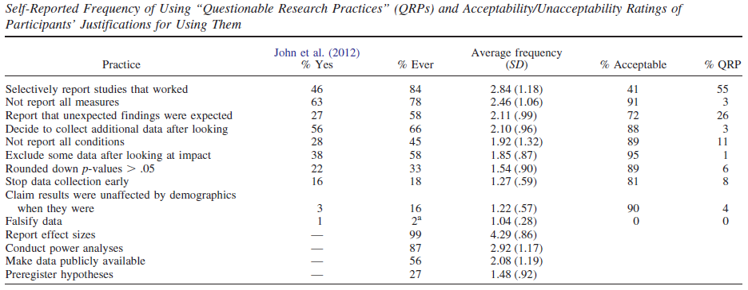
Results 1
Self-reported use of QRPs and best practices

Slide 13
Results 1
QRP – Justifications
Absolutely No
Absolutely Yes
Best Practices
Your opinions?
Your justifications?
What do you think?

Slide 14
Study 2
Aim
To examine the statistical support for the key hypothesis tests in some top journals
To examine the replicability of their results using some indices

Slide 15
Study 2
Research Integrity
Replicability
Statistical Power
Best Practices
(TIVA)
P-curve
Z-curve
Classical
Ambitious
Post hoc Observed Power
N-Pact (Sample Size)
R-Index
Exact p-value
Reporting Effect Size
Supl.

Slide 16
Study 2
Review & Critiques ?
Published indices vs. un-published indices
Counter-arguments?
Are indices valid?
Could there be other indices?
Are indices suitable?

Slide 17
Study 2
Method
Article selection
Article coding
Computation
Analysis.
Clear & understandable?

Slide 18
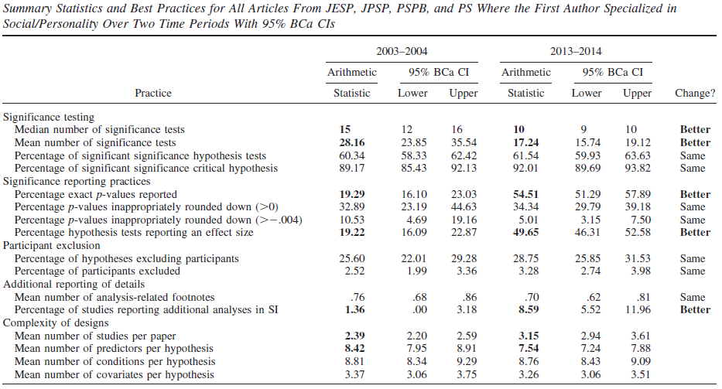
Results 2

Slide 19
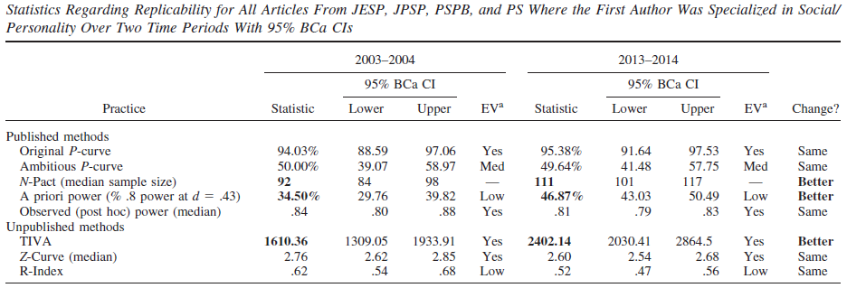
Results 2
IT’S GETTING BETTER & IT’S NOT SO BAD

Slide 20
Discusion
The clearest changes are
Greater consideration of statistical power
Collecting larger sample size
Reporting exact p-values and effect sizes
Appending supplemental info
ROTTEN TO THE CORE
IT’S NOT SO BAD

Slide 21
Discusion
Further questions?

Slide 22
THANK YOU!

